Slide 1

Technical Data Validation & Business Reconciliation

Slide 2
Introduction (Validation vs Reconciliation)
Confidential Draft – no decision has been made

Slide 3



Data Migration ETL Architecture
Extract
Transform
Construct
Translate & Load
Legacy Source Extracts
HR
PULL
ETL (BODS)
Finance
PULL
PULL
File Server
(bodsprdpi)
Data Source 3
Landing DB
Staging DB
Hoover
ETL (BODS)
ETL (BODS)
csv
Error
Reports
HR
HR
Hoover
DMT
File Server
(bodsprdpi)
Finance
csv
PULL
Finance
Data Source 4
PUSH
csv
Schema
Schema
csv
MS SQL Database Server
(bodsprddb01)
MS SQL Database Server
(bodsprddb01)
csv
H2 Database
Hoover
DTL
HTTPS
Data Source 5
PUSH
Index
H2 Database: Open Source Database
Hoover DMT: Data Migration Tool
Hoover DTL: Data Transformation and Loading Tool
Confidential Draft – no decision has been made

Slide 4
Data Validation
Confidential Draft – no decision has been made

Slide 5
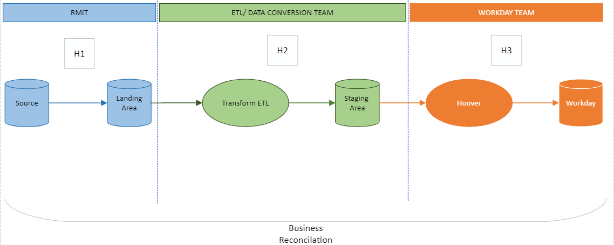
Data Conversion Flow

Slide 6
Data Conversion Flow – FIN : Customer
PPI_KNA1 - 111,056 rows
PPI_KNB1 - 111,546 rows
PPI_KNB5 - 187,874 rows
PPI_KNKK - 15,265 rows
PPI_KNKA - 15,196 rows
FIN_STG_CUSTOMER = 1,586 rows
1,586 Active
SAP Customers

Slide 7
Data Validation Framework
Compare the count of records for each data elements in the Source system with the data extracted for loading into Workday Landing tables
1
2
1
2
Check transformations applied to landing data as per the mapping specification
3
4
5
3
Make sure all the required field checks are applied as per mapping spec.
Compare the count of records for each data element in the stage tables with the data extracted from landing tables using filters mentioned in mapping specifications.
4
6
7
8
5
Check the uniqueness criteria defined in the file scope for each data element.
6
Utilize the QC framework reports, to check the required or crosswalk lookup fields do not have blank data.
9
7
RMIT Analyst validates the data for each data element before workday loads.
8
Load extracts into workday and Validate it for data issues like Data Type, duplicates etc.
9
Manually generate reports out of workday and validate it against Stage tables.

Slide 8
Validation Report Sample
Count validation Report
Subject Area | Extract Name | Input Row Count | Target Row Count | % loaded successfully | Error Record Count | Error record %
 | Stage table name | Landing table count after application of all filter criteria | Final Target Row count in staging tables | Records loaded successfully in Staging area | Error records which can include lookup failures as well | Error percentage
HR-AU | APPLICANTS | 500 | 200 | 40% | 300 | 60%
HR-AU | CREATE POSITION | 1000 | 1000 | 100% | 100 | 10%
HR-AU | HIRE EMPLOYEES | 100 | 100 | 100% | 0 | 0%
Error Report
Subject Area | Extract Name | Alternate Key | Stage Column Name | Error description | Error Type
 | Stage table name | Unique record identifier |  |  | Identify if the error is from transform stage or from conform stage
HR-VN | HIRE EMPLOYEES | v91201 | END_EMPLOYMENT_DATE | The data value cannot be converted for reasons other than sign mismatch or data overflow. | Destination Error
HR-AU | EMPLOYEE PERFORMANCE REVIEWS | E00000 | MANAGER_ID | A truncation caused a row to be redirected, based on the truncation disposition settings. | Conformance Error
HR-AU | EMPLOYEE PERFORMANCE REVIEWS | HRADMIN | EMPLOYEE_ID | A truncation caused a row to be redirected, based on the truncation disposition settings. | Conformance Error
HR-AU | EMPLOYEE PERFORMANCE REVIEWS | E00000 | MANAGER_ID | A truncation caused a row to be redirected, based on the truncation disposition settings. | Conformance Error

Slide 9
Data Validation (Error and Fix)
Confidential Draft – no decision has been made

Slide 10
Business Reconciliation
Confidential Draft – no decision has been made

Slide 11












Business Reconciliation
There are two main methods of validating converted data
Validation Reports
Manual Spot Check
Source Extracts
Transformed Data
Hoover
Workday
Sources
Transformed Data
Hoover
Workday
Sources
Source Data
Reports
Workday Reports
Compare
Compare
Custom Validation Reports are run out of Workday and then compared back to the source reports to see if any data was loaded incorrectly.
SAP ERP reports from the legacy source systems can be compared back to the Workday custom validation reports e.g. employee leave balance
Data owners can login to Workday and manually compare converted data back to the source system data.
Sample data can be extracted from the source systems to be compared back to the Workday data e.g. employee start date

Slide 12
Business Reconciliation Scenario
Confidential Draft – no decision has been made

Slide 13
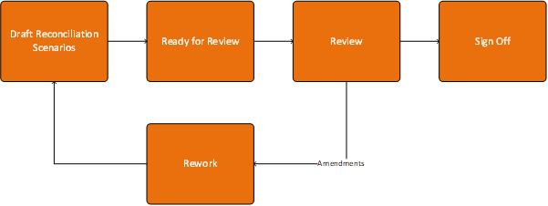
Reconciliation Scenario Lifecycle

Slide 14
Reconciliation Scenario Lifecycle
P2
SIT
UAT
DESIGN
LEARN
TEST
DESIGN
SIGNOFF
TEST
DESIGN
LEARN
TEST

Slide 15
Business Reconciliation Framework
Technical Data Validation
Execute Data Conversion
Complete Technical Validation
Business Data Reconciliation
Establish Data Cut-off Date
Define Reconciliation Scenarios
Review and Approve Reconciliation Scenarios
Extract reports or data from Legacy System(s) on Data Cut-off Date
Repeat until closure
Mark Reconciliation Scenario as Complete
Yes
Success
Execute Reconciliation scenarios
No
Raise Defect in JIRA
Triage and Resolve Defect
Generate Reconciliation Report
Approve Reconciliation Report
RMIT
Data Conversion

Slide 16
JIRA defect process
Confidential Draft – no decision has been made

Slide 17
Sign-off
Confidential Draft – no decision has been made

Slide 18
Appendix
Confidential Draft – no decision has been made

Slide 19
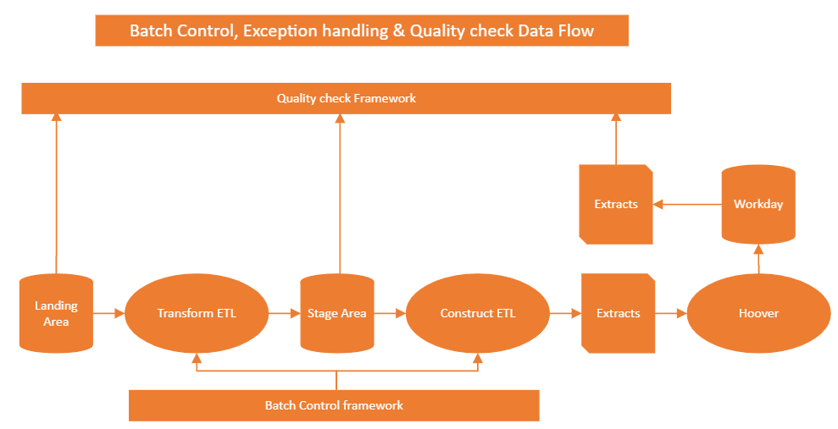
Data Validation Framework – Technical Components

Slide 20
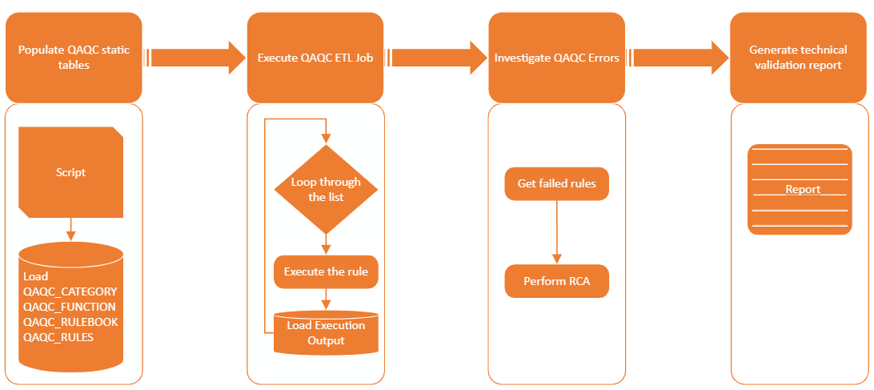
1. Quality Framework

Slide 21
2. Batch control Framework
ETL Execution dependency
ETL Load Summary
ETL Load Info
Row Count Info

Slide 22
Data Conversion Flow
Batch Control Framework
Quality check Framework

